Slide 1


Coronavirus (covid-19) StudY – Part 1
Understanding the relationship between Coronavirus (COVID-19) spread and the atmospheric pollution with meteorological data
By Stanley Tran

Slide 2



Introduction
The global Coronavirus cases has now passed over 13 millions and deaths already reaching over half a million. In order to slow the spread of the disease, we need to understand why some countries’ cases rise faster than others.
According to this research, one of the factors that could explain partially is the atmospheric pollution and the weather.
The current study is mainly focused on understanding the relationship between the daily increase of new cases and each of the different pollutants in the atmosphere. Additional study include the understanding of the relation between the cases and the meteorological data (humidity level, temperate, atmospheric pressure, wind speed and gust).

Slide 3
Overview of the study
For this first part of the project, the focus is the study of cases in Canada, Brazil, United States and Mexico.
Data from the World Air Quality project and Our World in Data are used in this study.
Note that the data used in this project are not fully verified or validated. These data may be subjected to change, error and correction.

Slide 4
Understanding Air Pollutants
Air pollutants are materials in the air that are detrimental to human health and the planet
Most air pollution comes from use of energy and production
Pollutants emitted into the atmosphere by human activity consists of the following:
- Carbon monoxide (CO)
- Sulfur dioxide (SO2)
- Nitrogen dioxide (NO2)
- Ground level ozone (O3)
- Particulate matter (PM)

Slide 5

Key Notes
In order to perform the analysis, the study is using the median of the pollutants level daily from the World Air Quality project dataset
Since different regions in the country have different level of pollutants, the average is done in order to get the pollutant level of the country daily to compare with the country new daily cases
Note that biases can happen in this study and the main goal is to observe if there is any relationship between the daily increase of new cases and each of the different pollutants in the atmosphere and the meteorological data (humidity level, temperate, atmospheric pressure, wind speed and gust)

Slide 6



Understanding the relationship between new cases and the atmospheric pollutants

Slide 7
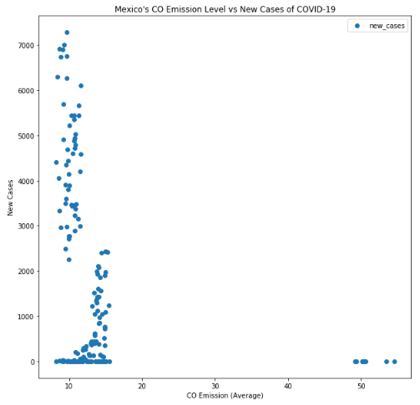
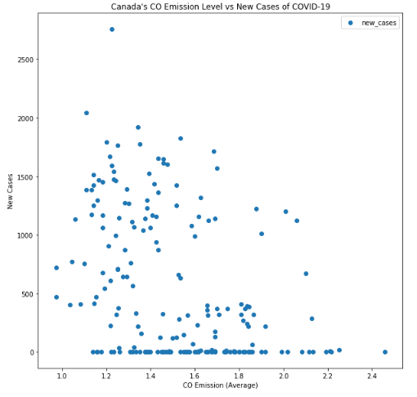
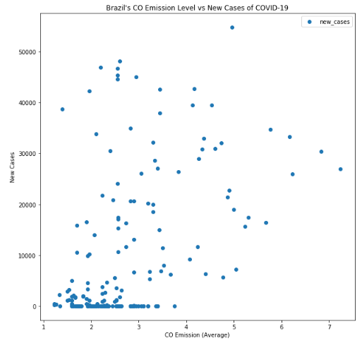
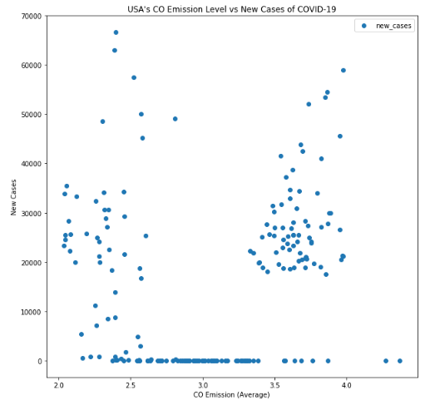
Comparison of new cases and CO Emission
Mexico
Canada
The level of CO emission in Mexico is around 10-15, which is the highest compared to other 3 countries
Canada’s level of CO emission is much lower (ranging between 1 and 2)
In USA, the level is between 2-4. Notice there is a huge cluster of new cases in the range of 30k with CO emission level ranging 3.5-4
In Brazil, the range varies widely from 1 to 7 and you can observe a direct relationship with the daily new cases
Brazil
USA

Slide 8
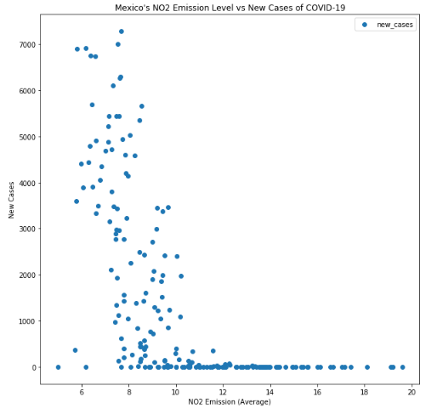
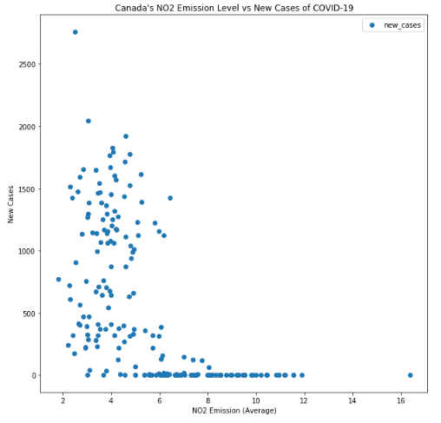
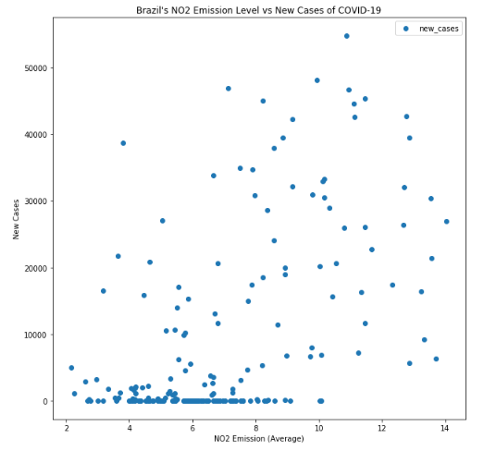
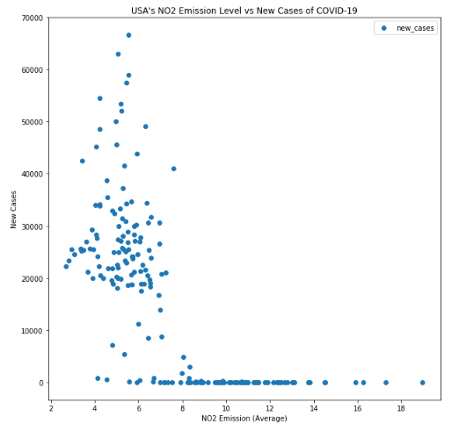
Comparison of new cases and NO2 Emission
Mexico
Canada
The level of NO2 emission in Mexico is around 6-10, which is the highest compared to other 3 countries
Canada’s level of NO2 emission is much lower (ranging between 2 and 6)
In USA, the level is between 4-8, second highest
In Brazil, the range varies widely from 2 to 14 and you can observe a direct relationship with the daily new cases
Brazil
USA

Slide 9
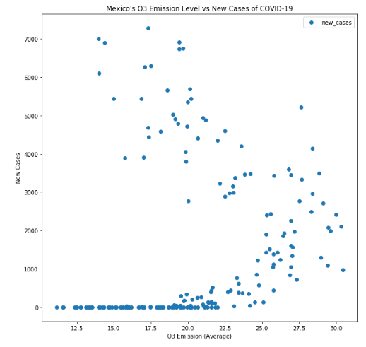
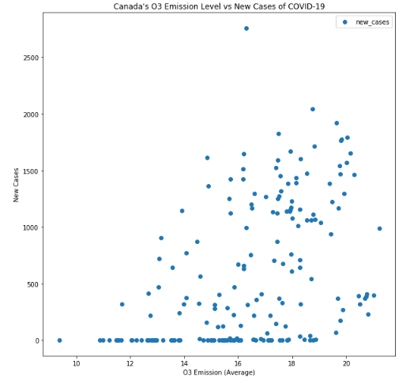
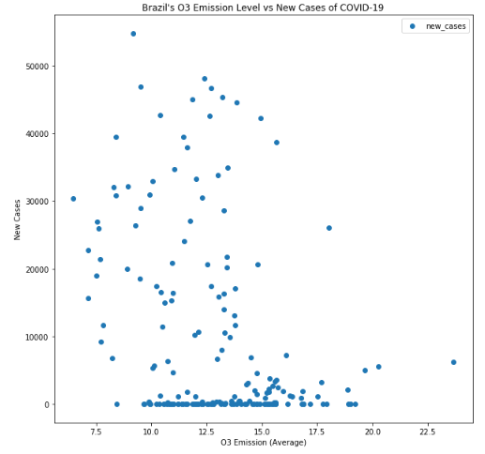
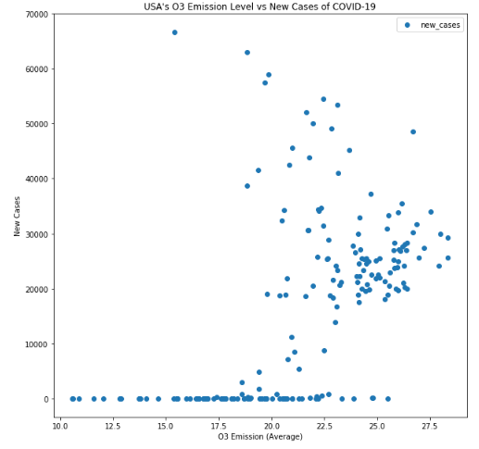
Comparison of new cases and O3 Emission
Mexico
Canada
The level of O3 emission in Mexico is one of the highest (ranging from 15 to 30) and USA being the second highest (ranging from 20 to 27.5)
The emission level of O3 seems lower (ranging from 10 to 20) in Canada and Brazil
You can observe a direct relationship with the new cases in Canada and Brazil
Brazil
USA

Slide 10
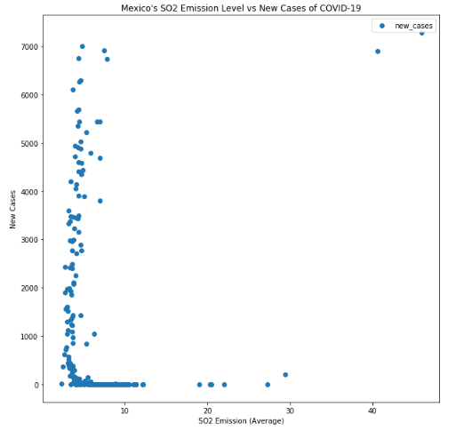
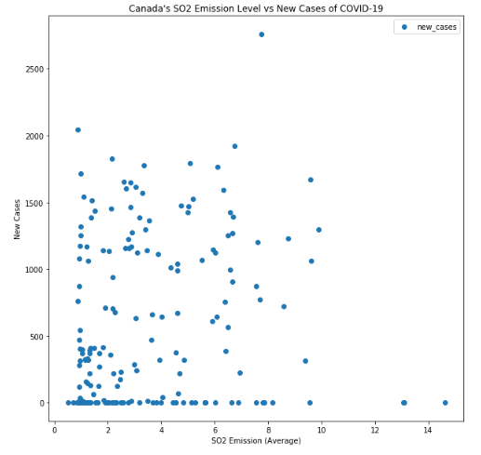
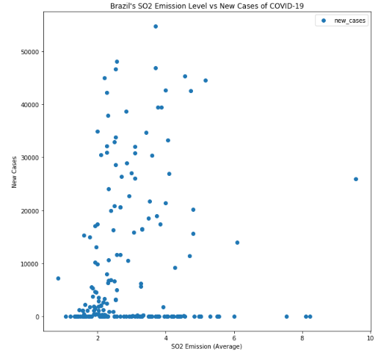
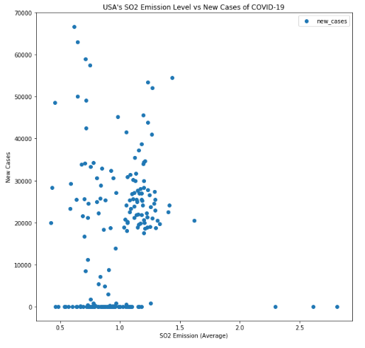
Comparison of new cases and SO2 Emission
Mexico
Canada
The level of SO2 emission in Mexico mostly remains under 10
Canada’s level of SO2 emission ranges between 2 and 10
In Brazil, the range varies widely from 2 to 6 and you can observe a direct relationship with the daily new cases
In USA, the emission of SO2 seems the lowest compared to other countries, ranging from 0.5 to 1.5
Brazil
USA

Slide 11
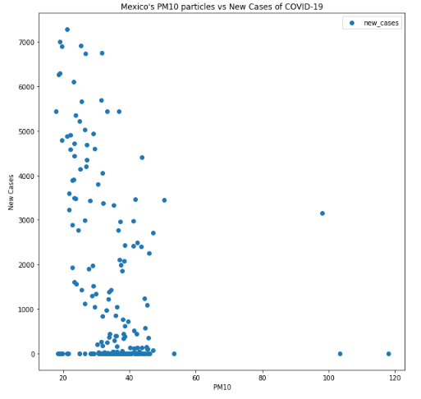
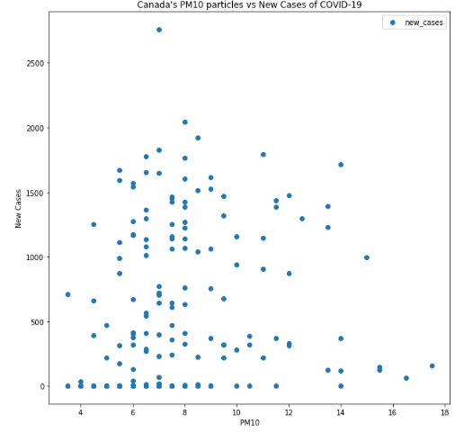
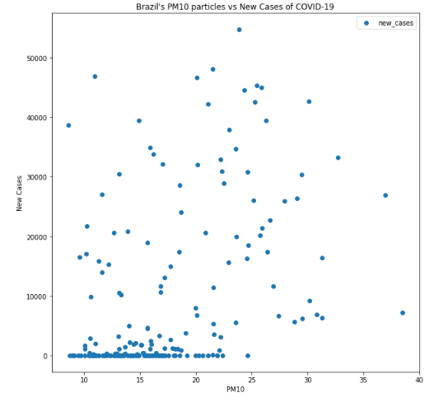
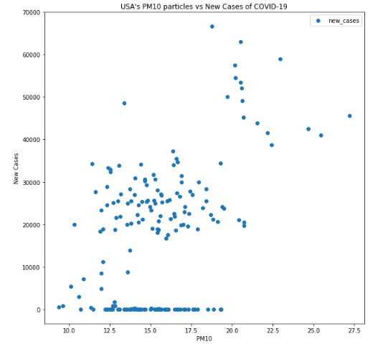
Comparison of new cases and PM10 particles Emission
Mexico
Canada
The level of PM10 particles emission in Mexico is the highest, ranging from 20 to 50
Canada’s level of PM10 particles emission ranges between 4 to 16
In Brazil, the range varies widely from 10 to 35 and you can observe a direct relationship with the daily new cases
In USA, the emission of PM10 particles seems to fall mostly between 10 and 20 (notice the cluster formed between this range)
Brazil
USA

Slide 12
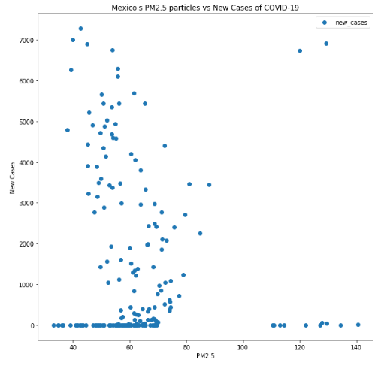
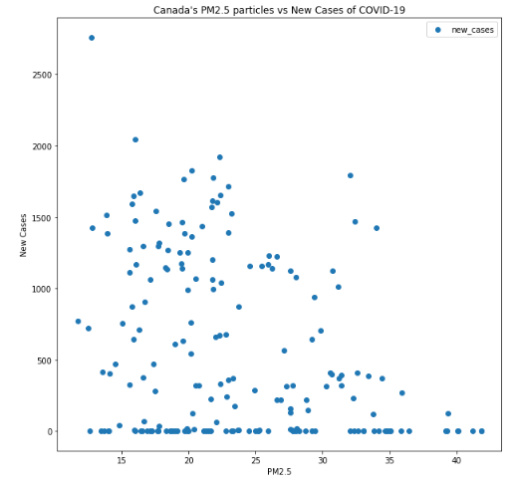
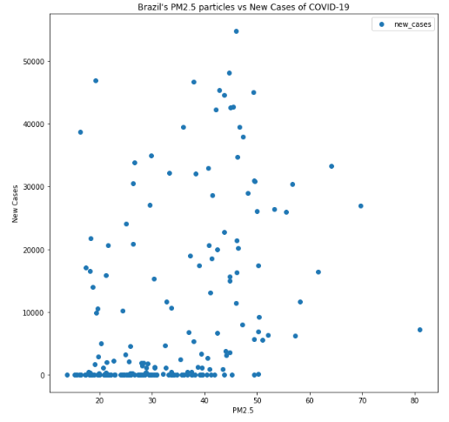
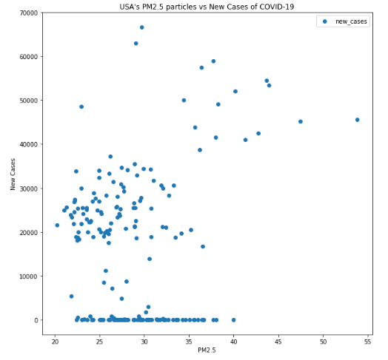
Comparison of new cases and PM2.5 particles Emission
Mexico
Canada
The level of PM2.5 particles emission in Mexico is the highest, ranging from 40 to 80
Canada’s level of PM2.5 particles emission ranges between 10 to 35
In Brazil, the range varies widely from 20 to 60 and you can observe a direct relationship with the daily new cases
In USA, the emission of PM2.5 particles seems to fall mostly between 20 and 40 (notice the cluster formed between this range)
Brazil
USA

Slide 13

Understanding the relationship between new cases and the weather

Slide 14
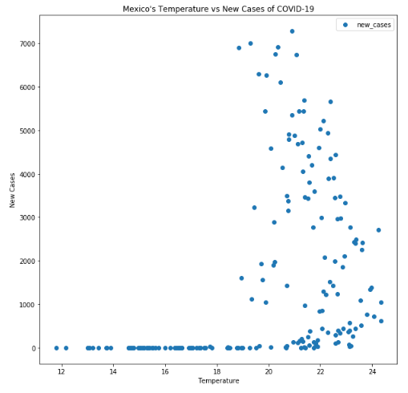
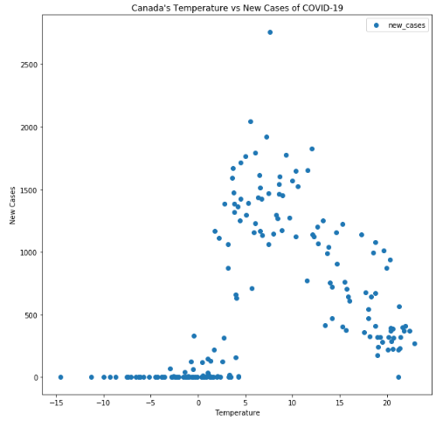
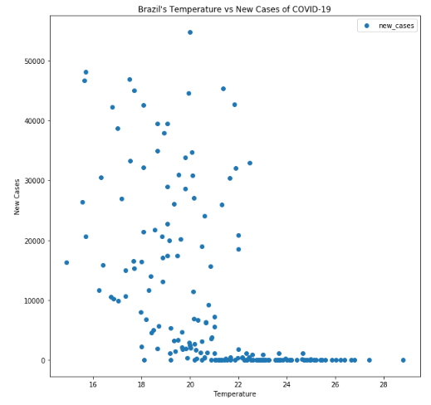
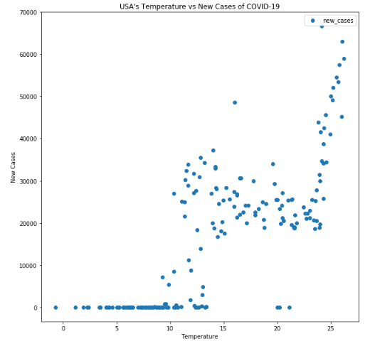
Comparison of new cases and Temperature
Mexico
Canada
In Canada, we can observe an indirect relationship of new daily cases with the temperature, in which we don’t see that in other countries
For the other countries outside Canada, notice that the range is between 10 to 25 degrees.
It remains hard to understand whether there is a direct or indirect relationship between the new daily cases and temperature
Brazil
USA

Slide 15
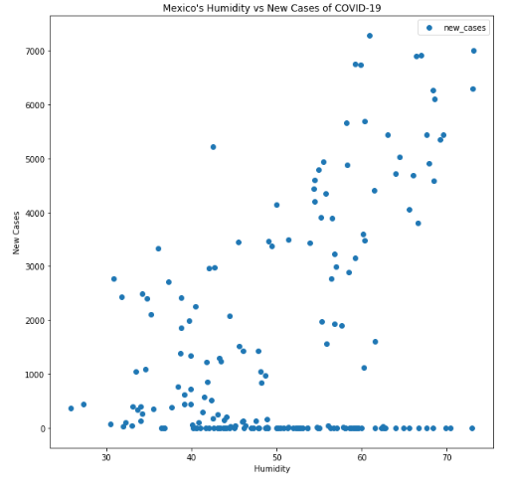
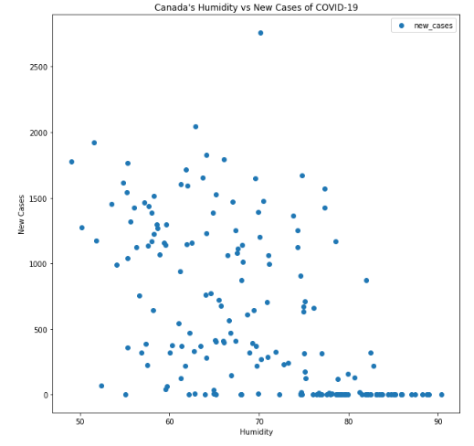
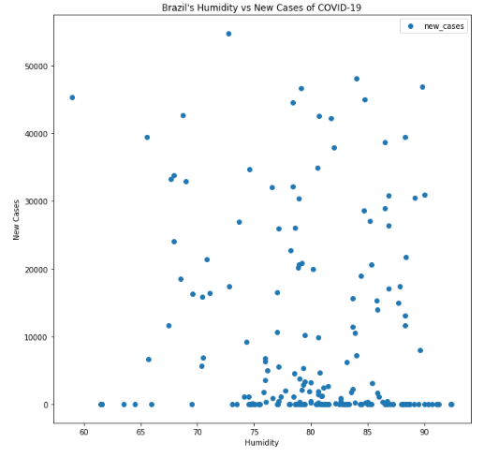
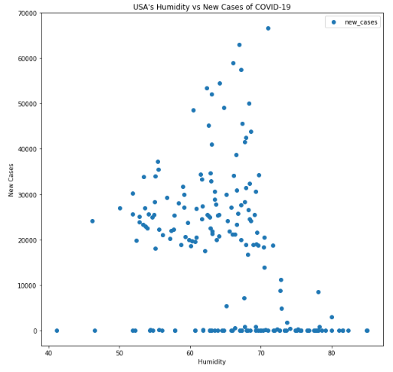
Comparison of new cases and Humidity level
Mexico
Canada
In Mexico, we can observe a direct relationship of new daily cases with the humidity level
If putting all data together, it seems that most increase cases are found in humidity level between 50 and 70 (roughtly)
Brazil
USA

Slide 16
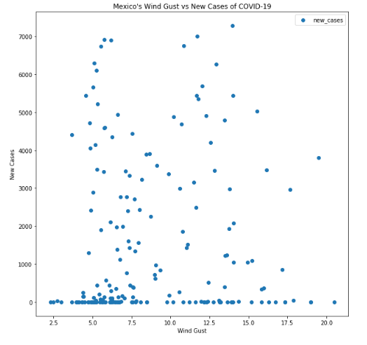
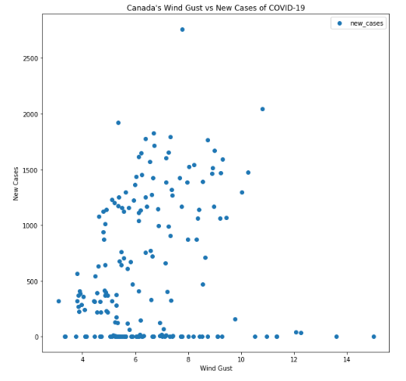
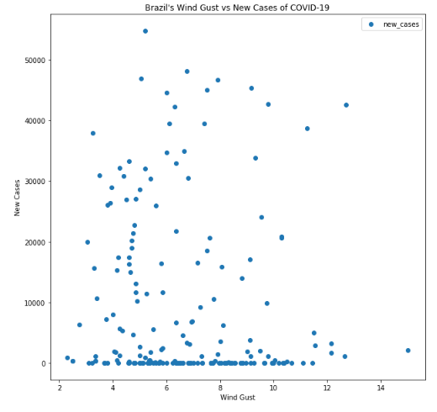
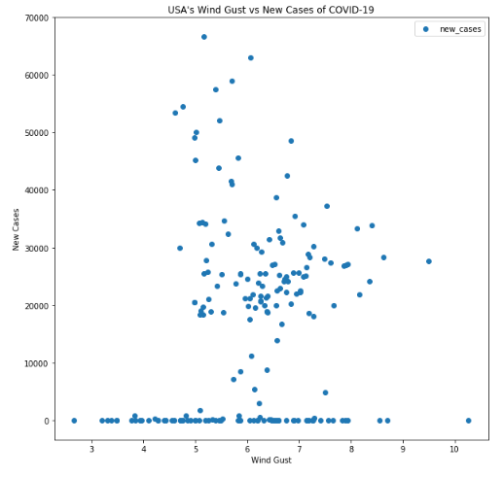
Comparison of new cases and wind gust
Mexico
Canada
In Mexico, Canada and Brazil, we can observe a direct relationship of new daily cases with the wind gust
In USA, most cases from a cluster for wind gust level between 5 and 8
Brazil
USA

Slide 17
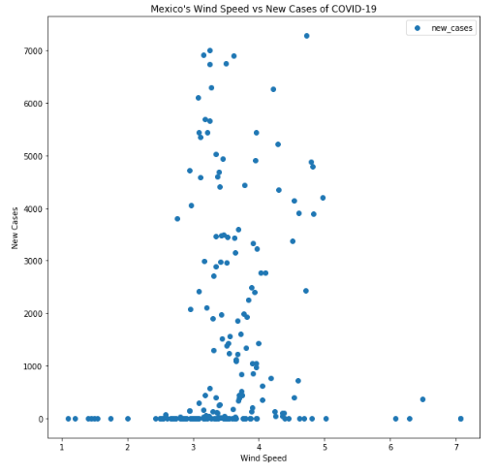
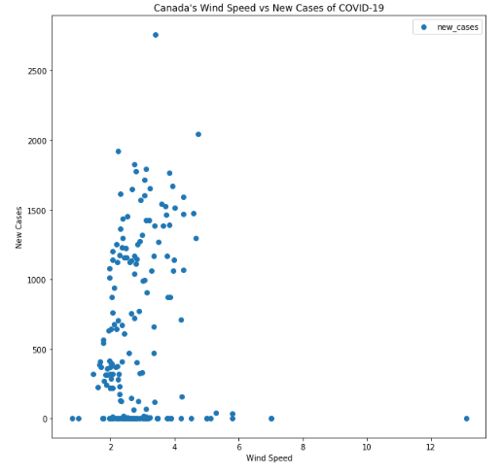
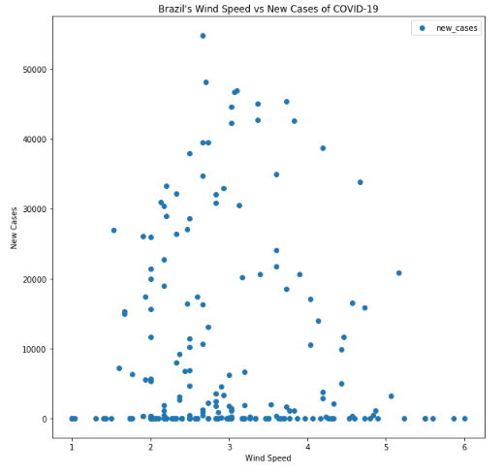
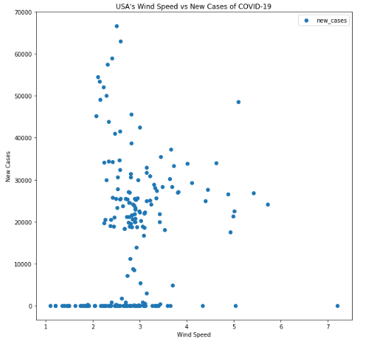
Comparison of new cases and wind Speed
Mexico
Canada
For all countries, the range of the wind speed falls between 2 and 5
With the data, it remains hard to see whether there is a direct or indirect relationship between new cases and wind speed
Brazil
USA

Slide 18

Analysis and insights

Slide 19
Analysis and INsights
After the first part of the study, we can observe a correlation between increase in cases with the exposure to air pollution and the weather
As this studies mainly focused on Canada, Brazil, USA and Mexico, further studies will need to expand for other countries
In addition, more factors needed to be considered in the study aside air pollutants and weather
Until now, with the data collected so far, the study remains non-conclusive

Slide 20

References
World Air Quality project
https://aqicn.org/data-platform/covid19/
Our World in Data
https://ourworldindata.org/coronavirus

